Slide 1
Business Strategies for Market Volatility
Navigating COVID19 Economic Fallout
Tom Leahey, Windham Brannon
April 15, 2020

Slide 2
Covid – 19; A generational executive challenge
Technology -breaches in times of stress
Showing proper care and support for employees
Covid-19
Challenges
Supply chains / distribution of services and products
Changing regulatory landscape
Intense financial stress

Slide 3
It’s different this time ….
2008 Financial Crisis
2020 COVID-19 Pandemic
Real economy crisis / corporate crisis
Built around massive demand shock
Tier 1 bank capital roughly $1.7T (Q4 19)
Banks - $250B incremental excess capital - liquidity requirements
Bank loss absorbency now 2X 2008 v. 2020
QOQ 2Q GDP -34% / job losses approaching 20 million
Stimulus package now $3T +
Banking system managing visible economic stress (lending v capital stress)
Market operating despite 95% of active participants working remotely; Credit markets “recovery transmission mechanism”
Bank led rescue
Vulnerable financial system
Tier 1 Capital $1T (2Q 08)
Questionable market liquidity and loss absorption ability
Only 8.6 million jobs lost
Liquidity buffers created
TARP program $900B
Unemployment peaked at 10.3%

Slide 4
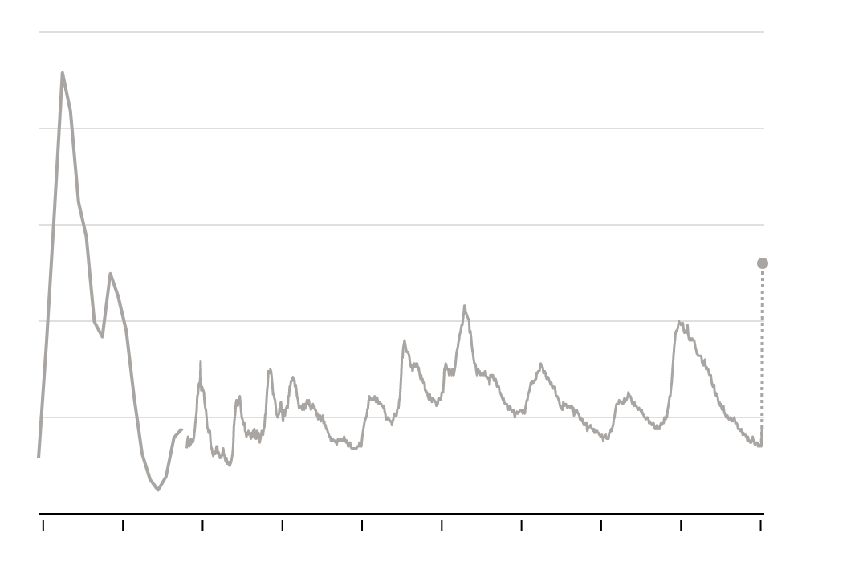
17 million job losses in past 21 days
U.S. Department of Labor Unemployment Rate 1930-2020
The real picture…
Feb and March unemployment rates 3.5% and 4.4% respectively – 50 year lows
Total U.S. labor force = 165 million
DOL reported 16.8 million job losses past three weeks
Gig workers (now covered) add roughly 1.5 million workers
The recent cycle has seen 6 million new hires each month.
Reporting lag as state unemployment offices are overwhelmed (perhaps up to 1 million workers)
Adding all of this together means that up to 20 million people without work.
NY Times – hard to know exact forward rate but estimates are in the range of 10% - 15% possibly as high as 20%.
20%
15%
13%?
10%
5%
1930
1940
1950
1960
1970
1980
1990
2000
2010
2020

Slide 5
Non - Farm payrolls - falling off a cliff
January 2008 – May 2020
RECESSION
27.9 million jobs are projected to be shed in March through May 2020
Millions
May 2020
Source: Labor Department, Oxford Economics

Slide 6
Strategic Growth Advisory
COVID-19 is demonstrating the importance of improved risk strategy and proactively seeking to determine what tools and analysis can be utilized to anticipate future volatility.
Capital Management
Finance leaders who have taken steps to contain risks related to COVID-19
EBITDA based covenants breaches as well as other measures will become more prevalent as borrowers face lower revenues and increased costs during the pandemic.
67%
64%
Considering taking further actions on costs or investments
Finance & Liquidity
80%
PE firms must evaluate impact to portfolio companies (reductions in operations, business interruptions). PE Returns may be muted as leverage components reset. May cause the need for additional equity for reentry.
Expect a FY 2020 decrease in revenue or profit. Two weeks ago, only 58% anticipated decreased revenue/profits.
Strategy
Business leaders must consider broadening cost-reduction measures and looking to shift supply chain strategies to mitigate the significant impact from COVID-19
Source: PwC US, “COVID-19 and the banking and capital markets industry”, March 17, 2020

Slide 7
The New Economic World
Covid – 19 has changed economies, social systems, consumer behaviors and what customers value and demand
Regulators have stepped in, competitors will react, employee motivations will change, politics will remain at the forefront and technology will continue to disrupt.
These forces are colliding at the same time, materially changing the system of business. The changes are swift and unprecedented
Resiliency is noble but – we will not simply snap back into form
Boards and “C” level should focus on renewal, adaptation to the new economic world

Slide 8
SGA Covid-19 Essential Skill Set
Execution in
New Economic
Environment
Reporting
& Enhanced Dash Board Creation
Dynamic Strategic Planning
SGA Advisory
Resources
Restructuring & Liquidity Planning
Capital Adequacy
Advanced Simulator Tools

Slide 9
How WB Helps
Turnaround Management
Financial Restructuring
Performance Improvement
Re-Capitalization
Stabilize client, develop winning strategy
Rationalize capital structure
Develop functional capabilities
Attract new partners/owners
Cost reduction
Liquidity generation strategy
Review of asset utilization
Review of structural organization
Liquidity management
Balance Sheet/P&L Restructuring
Working Capital
Debt workout negotiations
Strategic planning
Financial planning & forecasting
Business process re-engineering
Value enhancement
Corporate valuation
Investor research
Target identification
Strategic buyer negotiations

Slide 10
SG&A – Capital Management
Financial Covenants
1
At the end of 1Q20 (and certainly 2Q20), borrowers who may be in violation of debt covenants as a result of the the pandemic should proactively approach lenders to discuss obtaining amendments to covenants and structural relief (forbearance).
Covenant Compliance
Amendments and Waivers of Debt
Amendments & Waivers
Liquidity Management
Cost Savings Measures
Limited Cash Leakage
2
Lenders and borrowers should be familiar with the amendment and waiver provisions in their loan documentation, including the voting requirements for different types of amendments or waivers.
4
Refinance
Capital resourcing
Identify New Capital Sources
Borrowers must make provisions for financing expansion as lenders will apply stringent requirements to structured loans as debt issuances retract.
3
Source: Arnold&Porter, “Key Issues in Loan Agreements Relating to the COVID-19 Pandemic”, March 23, 2020

Slide 11
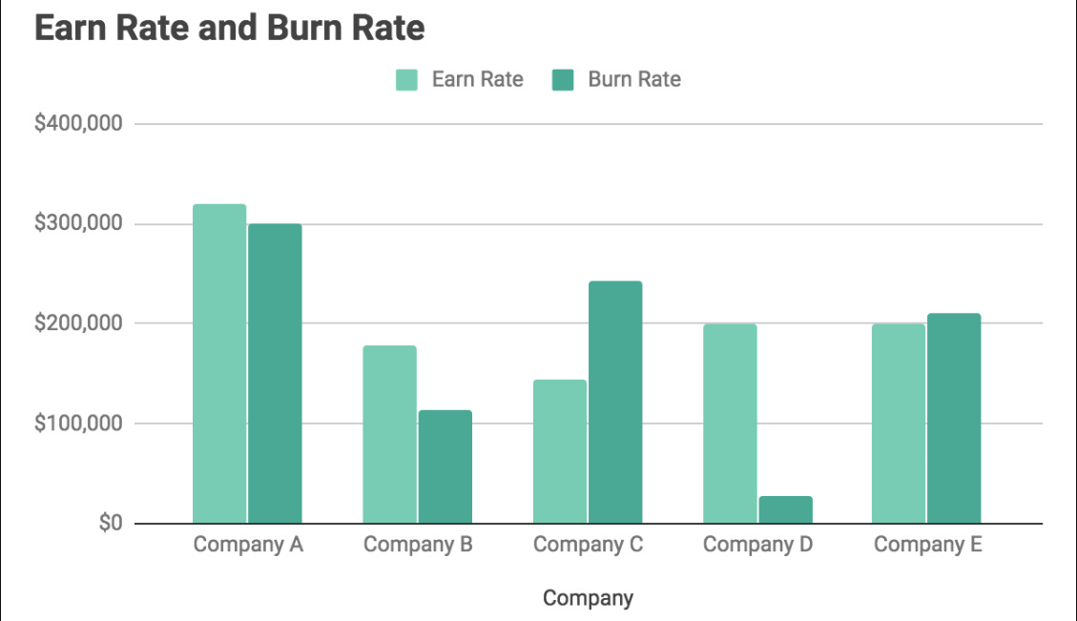
SG&A – Finance & Liquidity
By allowing clients to remotely upload financial data directly – WB can employ its comprehensive risk simulator which can - at a distance - safely guide firms through periods of extended volatility
Burn rate analysis: Identifying the amount of monthly cash spend to generate income
Runway analysis: To what length of time can a company remain solvent under volatile market conditions?
Cash-flow analysis: Detailed cash-flow forecasting and bolstered financial planning as part of a comprehensive risk assessment
Source: PwC US, “COVID-19 and the private equity industry”, March 17, 2020

Slide 12
SG&A - Strategy
Amidst the COVID-19 outbreak, customer behavior (for both B2B and B2C clients) has drastically changed. Consumers are staying at home – shifting consumption habits toward those products needed to survive the crisis. Additionally, companies have had to ramp down production and slow purchases.
Revise your sales strategy to adjust to evolving customer behaviors and the competitive environment
For PE firms, this means a drastic shift in ongoing business strategy. Companies that cannot adapt will be struck with the kind of disruption that dampens business or, in the worst case, ends a company’s prospects for survival
Focus strategy on protecting customer relationships and commercial instruments/advantage
Integrate customer behavioral changes into financial forecast and liquidity projections
Innovate and invest within dominant product segments/sales channels
Source: PwC US, “COVID-19 and the private equity industry”, March 17, 2020

Slide 13
If I were the boss… 5 things that I would do today…
Get capital house in order – this will cost you! Goes way beyond what SBA can offer
Add brain power to your organization - Make BI, data analytics, planning and analysis core competencies. Focus on better information, surgical and nimble strike ability, tighter integration and data based management
Develop cross functional response teams – encourage teams to cut across functional lines and of time honored traditions
Build a bottom up & top down plan – you are not the only one effected
Be specific in how you can put some distance on your competitors
Consider macro and micro environment
Use the opportunity to enhance technology, security, digital, digital personality, digital sales channel – this could be the new world.

Slide 14
Real World Plans…
Air travel – passengers grab their own snacks as they board. Emphasize plane and terminal cleaning
Starbucks – Stepped up cleaning, paying workers to quarantine, pushing ”to go” orders, limited hours, reduced seating
Toyota – production lines operate at slower speeds to maintain distancing. On- site health screenings
MLB – staging a single location season, sequestering players and personnel
Disney – temperature checks for guests (“customers demand that we scrutinize everybody.”)
Large offices - rotational work force (“de densification”), six foot office – shields divide desks, desk pads catch germs and are discarded when workers leave for the day
Texas Roadhouse Restaurant – open at reduced capacity, may install Plexiglas dividers, separate waiting areas
Panera Bread – will need to find new channels of revenue – makeshift grocery stores, to go orders.
Certain colleges – back to single occupant dorms, student on campus for shorter terms modules

Slide 15
Questions?

Slide 16
Contact
Tom Leahey, Windham Brannon
Principal & Practice Leader, Strategic Growth Advisory
tleahey@windhambrannon.com
770.314.1611

